Slide 1
Introduction to jQuery Braelyn Sullivan | Consultant
Notes:
Welcome to our introduction to jquery workshop

Slide 2

Agenda
Intended Audience
Brief History of jQuery
Using Selectors
Dynamic Styling
DOM Manipulation
Event Handling
Q&A
Braelyn Sullivan Front End Consultant
Notes:
My name is Braelyn Sullivan and I am a Front End consultant with CapTech Ventures, a sponsor of this event.
In this workshop, we will go over the following items:
Intended audience
A brief history of jquery
Using selectors
Dynamic styling
DOM Manipulation
Event handling
Q&A Session

Slide 3
Intended Audience
No prior knowledge required for this session
HTML & CSS knowledge will be helpful
Advanced JavaScript users may find other session(s) more helpful
Notes:
Intended for beginners.
The material we will cover requires no previous knowledge; however, some knowledge of HTML and CSS will be helpful in understanding the examples.
Any advanced JavaScript or web developers may find another session more valuable

Slide 4
What is jQuery?
One of the most widely deployed JavaScript libraries in the world
Document Object Model (DOM) Manipulation library
Designed to simplify client-side scripting of HTML:
Navigate the DOM
Create/Remove elements
Event handlers
Animations*
Ajax*
Still being maintained and updated today
https://jquery.com/
*Not covered in this session
Notes:
jQuery is one of the most widely deployed JavaScript libraries worldwide
It is primarily a Document Object Model, or DOM, manipulation library
jQuery was designed to simplify client-side scripting of HTML by using css selectors to
Navigate the DOM
Create/Remove elements
Event handling
Animations and effects
Ajax / Server interactions
NOTE: Animations and Ajax are advanced topics that will not be covered in this session
jQuery is still being maintained and updated today
Check the jquery website for more information or updates

Slide 5
History of jQuery
2006
2008
2013
2018
First stable release of jQuery
Microsoft and Nokia announce support for jQuery
jQuery 2.0 stable released
Current Version: 3.3.1 released
jQuery UI introduced
jQuery Mobile announced and released
jQuery 3.0 released
2007
2010
2016
Notes:
This is a very brief history of jQuery:
The first stable version of jQuery was released for use in 2006
By 2007, the first jQuery extension, jQuery UI, was released
In 2008, Microsoft and Nokie bundled jQuery into their services
2010 brought jQuery into the mobile realm with the jQuery Mobile extension
Following many smaller updates, jQuery 2.0 released in 2013
The latest major version 3.0 was released in 2016
That brings us to today… v3.3.1 was released just last month

Slide 6
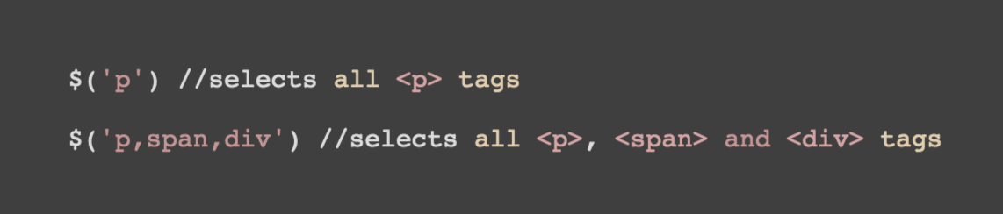
Using Selectors
Tag / Element Selectors
Selects all elements with the given tag name

Slide 7
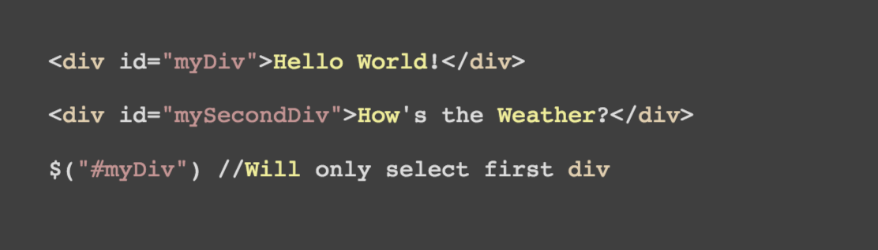
Using Selectors
ID Selectors
Selects single element with the given id attribute

Slide 8
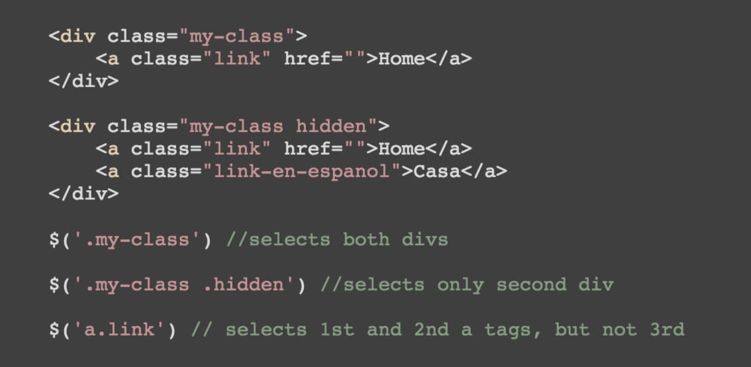
Using Selectors
Class Selectors
Selects all elements with the given class attribute

Slide 9
Using Selectors
Attribute Selectors
Selects all elements identified by a specified attribute

Slide 10
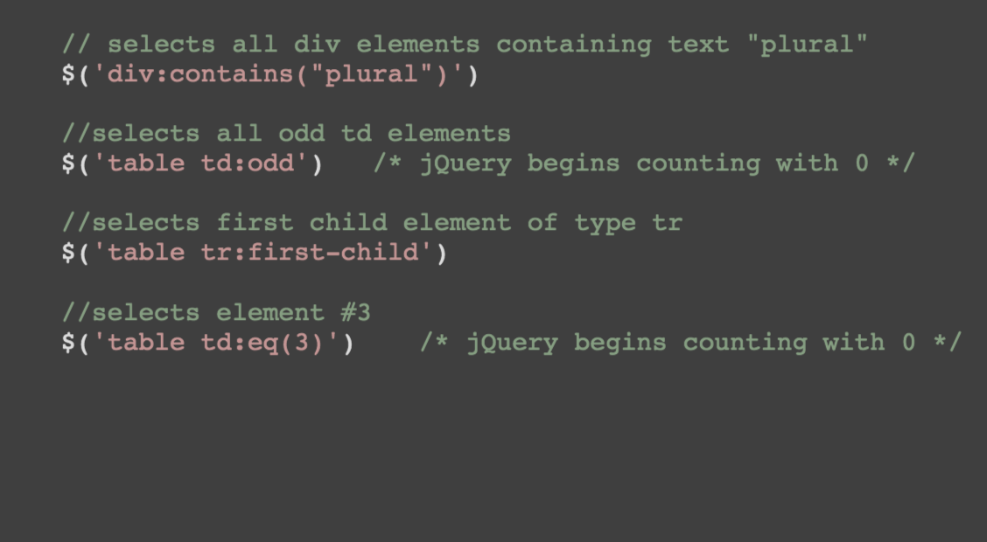
Using Selectors
Additional Selectors
Other examples that could be useful

Slide 11
Using Selectors
Reference
Use the jQuery API Docs for complete list of selectors and additional examples: https://api.jquery.com/

Slide 12
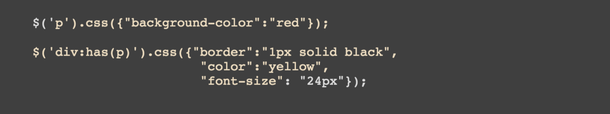
Dynamic Styling
.css()
How can we change the style of DOM objects dynamically?
We could use the .css() method
…but there is an easier way!

Slide 13
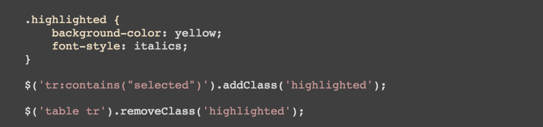
Dynamic Styling
Add / Remove Class
Methods to add or remove specific class from targeted element

Slide 14
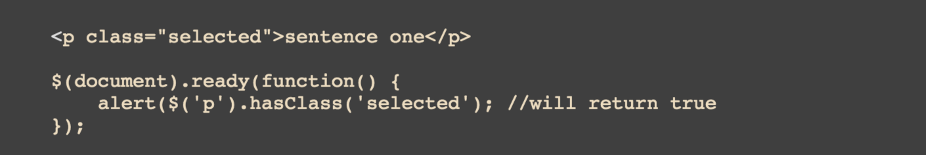
Dynamic Styling
Has Class
Methods to test for specific class on targeted element

Slide 15
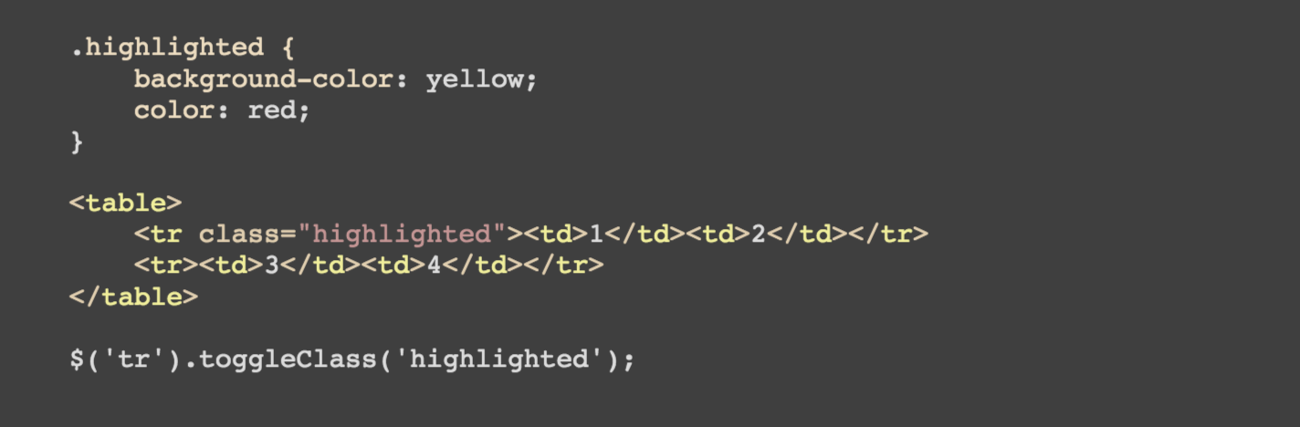
Dynamic Styling
Toggle Class
Methods to combine add/remove class methods on targeted element

Slide 16
Dynamic Styling
Reference
Use the jQuery API Docs for additional examples: https://api.jquery.com/

Slide 17
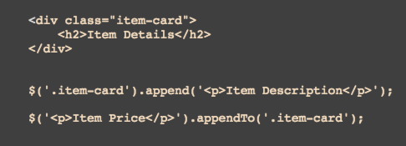
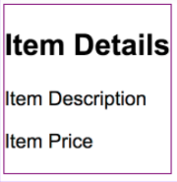
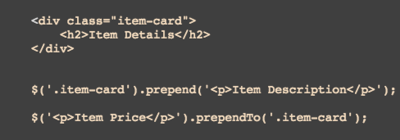
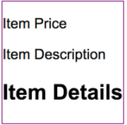
DOM Manipulation
Adding DOM Elements
.append() and .appendTo()
.prepend() and .prependTo()

Slide 18
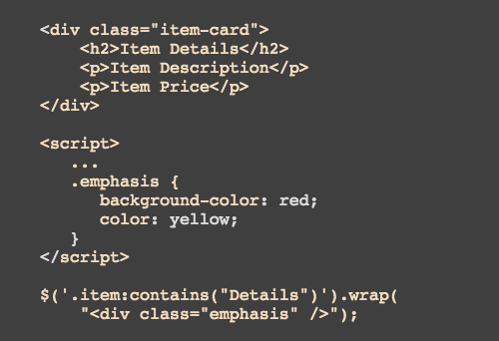
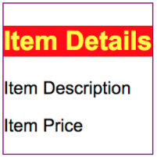
DOM Manipulation
Wrapping DOM Elements
.wrap()

Slide 19
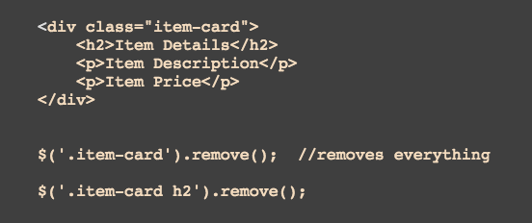
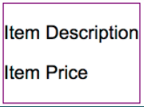
DOM Manipulation
Removing DOM Elements
.remove()

Slide 20
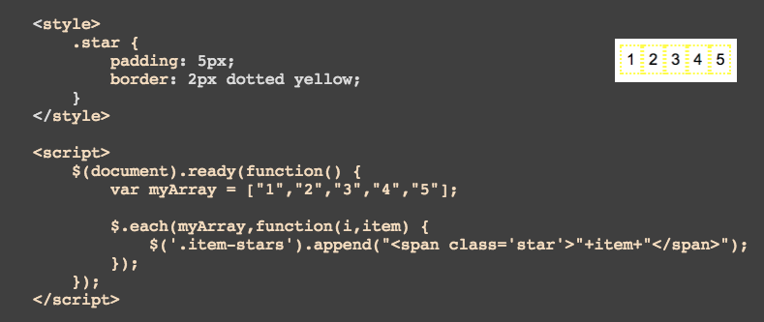
DOM Manipulation
Iterating Through DOM Elements
$.each()

Slide 21
DOM Manipulation
Reference
Use the jQuery API Docs for a complete list of methods and additional examples: https://api.jquery.com/

Slide 22
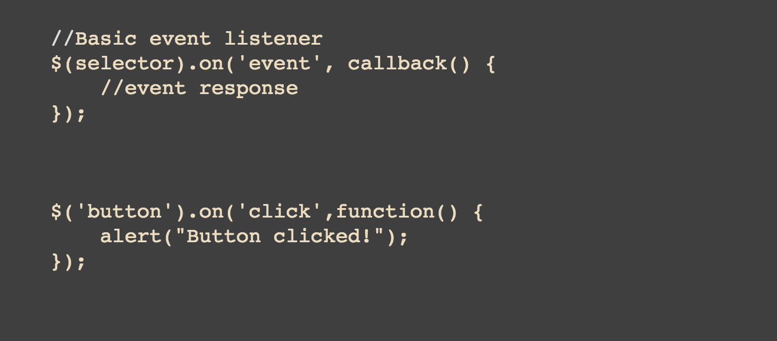
Event Handling
Event Basics
Event Listener syntax

Slide 23
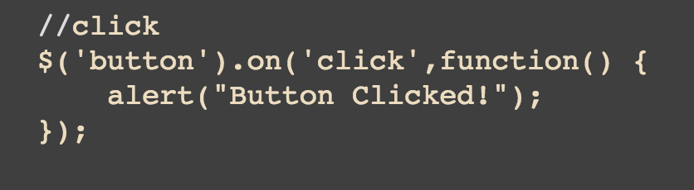
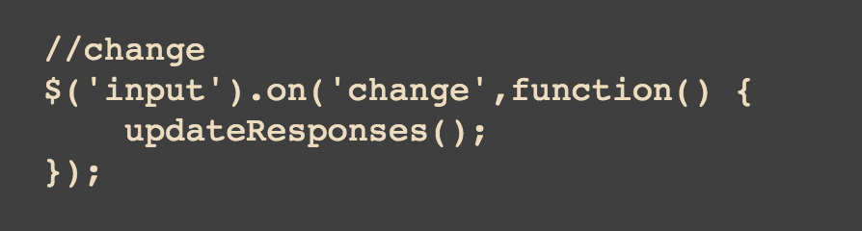
Event Handling
Types of Events
Click event
Change event

Slide 24
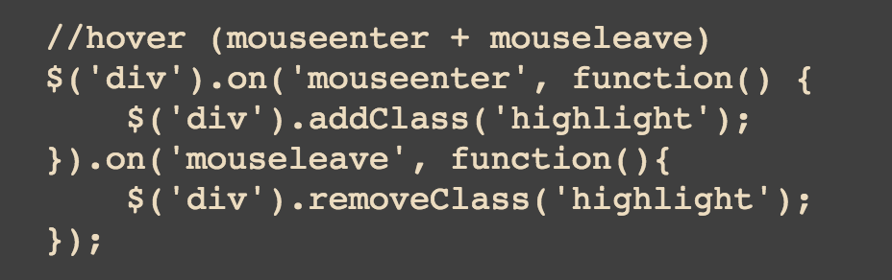
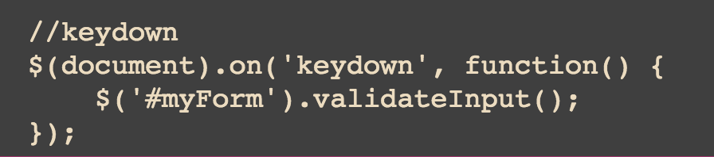
Event Handling
Types of Events
“Hover” event
Keydown event

Slide 25
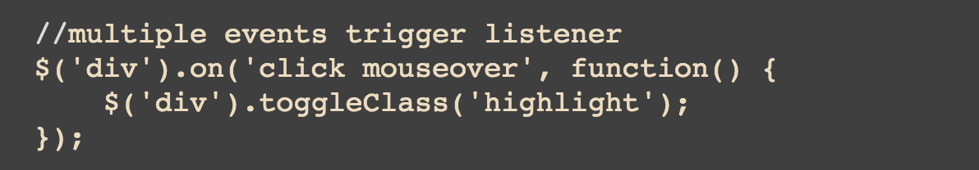
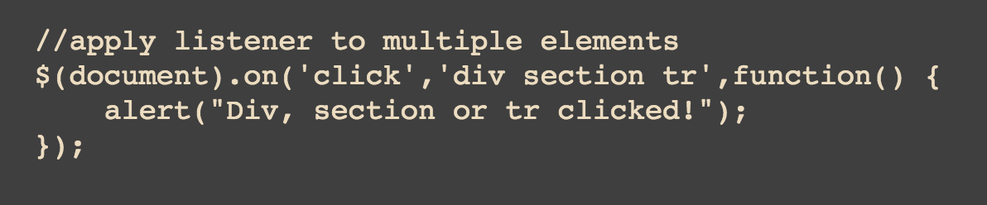
Event Handling
Multiple Item Events
Multiple items trigger same event
Apply listener to multiple elements

Slide 26
Event Handling
Reference
Use the jQuery API Docs for a complete list of methods and additional examples: https://api.jquery.com/

Slide 27
Any Questions?
Bsullivan@captechconsulting.com
Slides available for download at github.com/brsullivan

Slide 28
Thank You

